Slide 1
Inversion of Control with Castle Windsor
Daniel Hölbling
http://www.tigraine.at
tigraine@tigraine.at

Slide 2
Agenda
Why Inversion of Control
Short intro of the problem
Live coding session
Using the Windsor Container

Slide 3
Complexity
Code that directly depends on other components
Leads to monolithic systems
Those systems are hard to test and maintain

Slide 4
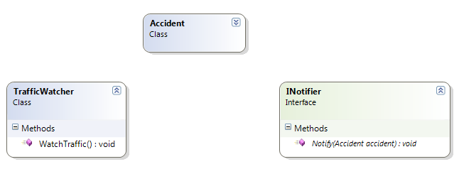
Scenario: Traffic watcher
Application that monitors Traffic.
Should send alarms in case of accident
calls

Slide 5
The TrafficWatcher
Has nothing to do with notifying
The only “real” responsibility.

Slide 6
The Truth
Construction
Configuration
Actual work

Slide 7
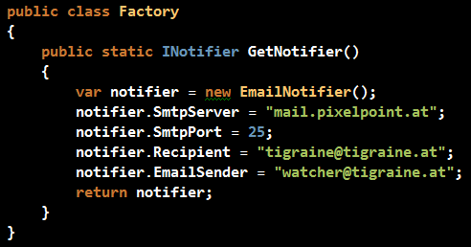
Factory
So and how are we supposed
to test this?
TrafficWatcher DEPENDS on Factory

Slide 8
Dependency injection
Notifier gets passed to Watcher
No construction/retrieval in
the TrafficWatcher
Clean ☺

Slide 9
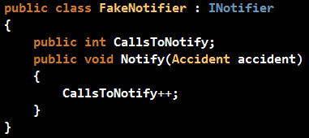
Testable!
Yay! We can test Trafficwatcher
without any real Notifier

Slide 10
Castle Windsor Container
A flexible component built to take care of object graph construction
There are other containers too:
Unity, StructureMap, nInject… in .NET
Guice, Loom, Pico... in Java
(rolling your own is rather simple ☺)

Slide 11
Coding
Time for even more code ☺

Slide 12
Suggested reading
Ayende Rahien (http://www.ayende.com)
Robert C. Martin
Martin Fowler(http://martinfowler.com/)
Miško Hevery (http://misko.hevery.com/)
Rob Conery (blog.wekeroad.com/)
CodeBetter.com

Slide 13
Thanks for listening!
http://www.castleproject.org/container/
http://www.tigraine.at

